Slide 1

HTML

Slide 2
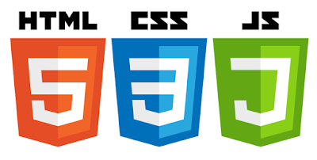
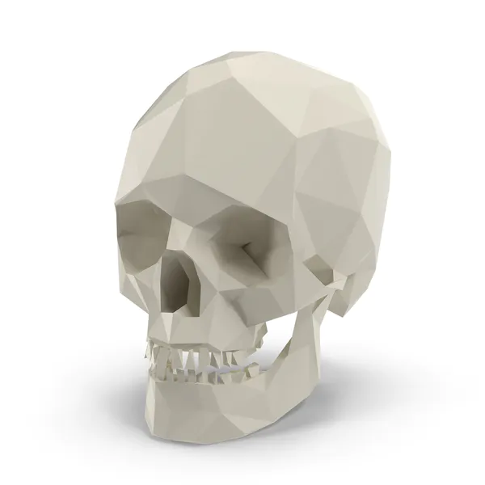


Introduction
Introduction to web technologies:
HTML to create the document structure and content
CSS to control is visual aspect
JavaScript for interactivity

Slide 3
HTML is a language for describing web pages.
Tim Berners Lee-author name
HTML stands for Hyper Text Markup Language
HTML is not a programming language, it is a markup language
A markup language is a set of markup tags
HTML uses markup tags to describe web pages

Slide 4
What is HTML?
● HTML is the standard markup language for creating Web pages.
● HTML stands for Hyper Text Markup Language
● HTML describes the structure of Web pages using markup
● HTML elements are the building blocks of HTML pages
● HTML elements are represented by tags
● HTML tags label pieces of content such as "heading", "paragraph", "table",...
● Browsers do not display the HTML tags, but use them to render the content of the page

Slide 5
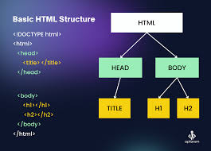
Basic Structure

Slide 6
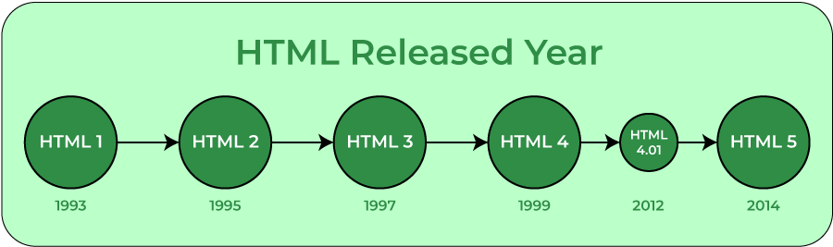
Versions

Slide 7
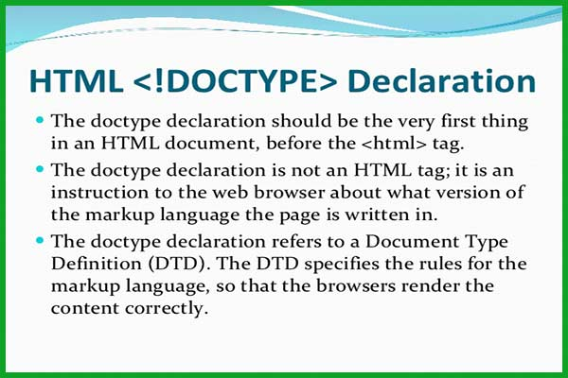
Doctype?

Slide 8
HOW TO CREATE AN HTML DOCUMENT
The essential tags that are required to create a HTML document are:
<HTML>.............</HTML>
<HEAD>.............</HEAD>
<BODY>.............</BODY>

Slide 9
First HTML Page: Tags
<!DOCTYPE HTML>
<html>
<head>
<title>My First HTML Page</title>
</head>
<body>
<p>This is some text...</p>
</body>
</html>
Opening tag
Closing tag
An HTML element consists of an opening tag, a closing tag and the content inside.

Slide 10
Head inside ?
Document Title (<title>)
Character Encoding (<meta charset="">)
The character encoding declaration ensures that the web browser interprets the text correctly. Common character encodings include UTF-8, which supports various characters and symbols.

Slide 11
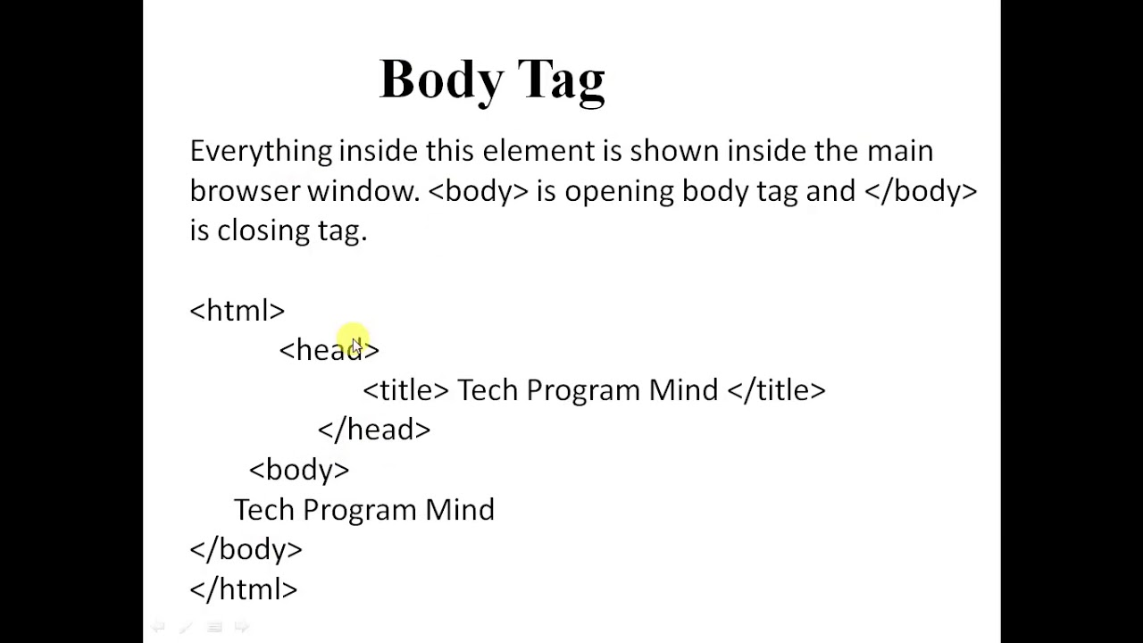
Body inside?

Slide 12
Tools
Visual Studio
Download and Install
Create Workspace
Open Workspace inside tool
Start create html file

Slide 13
Thank you

